Slide 1
Secure data hiding in images using steganography
CAPSTONE PROJECT
Presented By:
Student Name : Neeradi Aryan Raj
College Name & Department : Holy Mari Institute of Technology and Science & CSE

Slide 2
OUTLINE
Problem Statement
Technology used
Wow factor
End users
Result
Conclusion
Git-hub Link
Future scope

Slide 3
Problem Statement
In today's digital world, securely transmitting sensitive information is a challenge. Traditional methods of data hiding are vulnerable to attacks and unauthorized access. This project implements steganography with encryption, allowing users to hide confidential messages inside images securely. The data is first encrypted using a password before embedding, ensuring an extra layer of protection. The system also provides a decryption mechanism, allowing only authorized users to retrieve the hidden data. This approach enhances data security, privacy, and confidentiality in communication.

Slide 4
Technology used
Programming Language: Python
Libraries: CV2, String, OS

Slide 5
Wow factors
Steganography Magic – Hides secret messages inside images invisibly!
Lightweight & Fast – Uses simple ASCII encoding without heavy encryption.
Passcode Protection – Only decrypts if the correct passcode is entered.
Creative Pixel Manipulation – Embeds text into RGB values of an image.
Instant Preview – Automatically opens the encrypted image after processing.

Slide 6
End users
Cybersecurity Enthusiasts – Explore hidden message encryption techniques. Forensic Investigators – Retrieve hidden data from image files.
Privacy-Conscious Users – Securely store confidential messages.
Spy & Intelligence Agencies – Covert communication without detection.
Students & Researchers – Learn about image-based data hiding techniques.

Slide 7
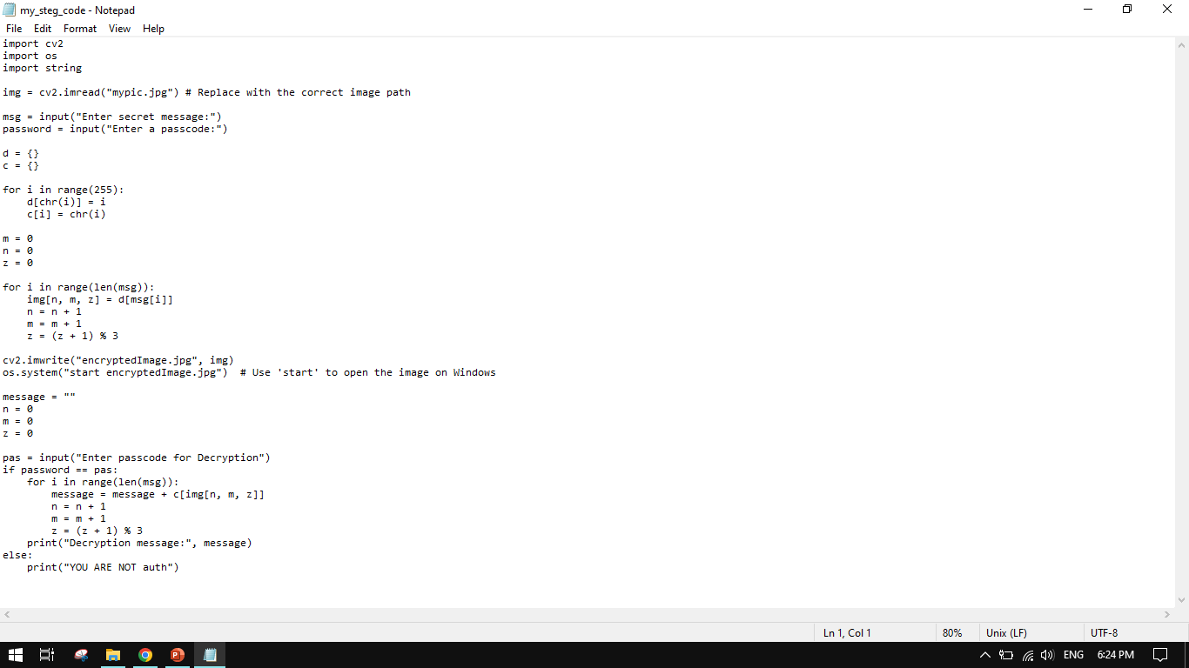

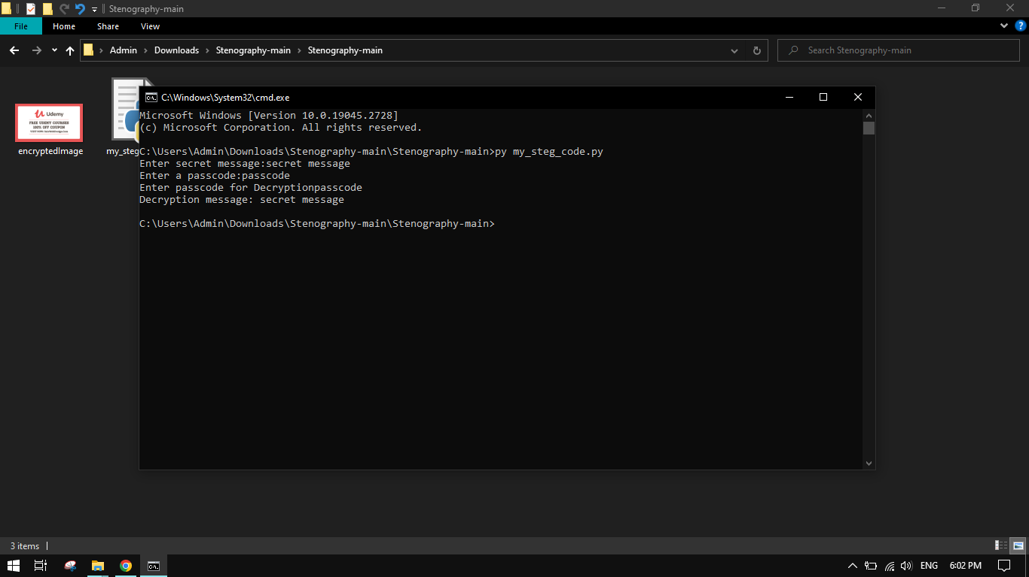

Results

Slide 8
Conclusion
Innovative Approach – Uses steganography to hide messages in images.
Simple Yet Effective – Lightweight implementation with basic encryption.
Enhanced Privacy – Protects sensitive data with passcode-based access
Real-World Applications – Useful for cybersecurity, forensics, and secure communication.
Future Scope – Can be improved with stronger encryption and better storage techniques.

Slide 9
GitHub Link
https://github.com/Aryan-Raj-Neeradi/AICET-STEG-PROJECT.git

Slide 10
Future scope(optional)
Advanced Encryption – Integrate AES or RSA for stronger security.
Improved Storage Efficiency – Optimize pixel modification to store more data.
AI-Powered Steganalysis – Detect hidden messages with machine learning.
Cross-Platform Compatibility – Enhance support for different OS and image formats.
Steganography in Videos – Extend the concept to video frames for larger data hiding.

Slide 11
THANK YOU

